Slide 1
Project Presentation of CO-OP Project at Industry (Module-2) (22CS421)
On
ERRAM : Emotional Reliance Risk Assessment Model
Submitted by: Niharika Kapoor(2210991973)
Kritika Bansal(2210990524)
Submitted to: Dr Lalit Sharma
Department of Computer Science and Engineering, Chitkara University

Slide 2
Introduction
Conversational AI systems are increasingly being used not only for information retrieval but also as emotional outlets, especially among students and young users.
People often find AI:
Easily accessible
Non-judgmental
Available 24/7
However, this creates a challenge: There is no mechanism to monitor emotional reliance, which may lead to unhealthy dependency patterns.
ERRAM addresses this gap by providing real-time emotional risk assessment from user input.
2

Slide 3
Problem Statement
With the growing adoption of AI chat systems:
Users are forming emotional connections with AI
Sensitive thoughts are being shared with machines instead of humans
There is no feedback system to alert users about emotional distress
This lack of monitoring may result in:
Increased emotional dependency
Social isolation
Ignored mental health signals
Hence, there is a need for a system that can analyze user input and indicate emotional risk levels.
3

Slide 4
Objectives
The primary objective of ERRAM is to:
Analyze user-generated text input
Classify emotional risk into:
Low Risk
Medium Risk
High Risk
Additionally, the system aims to:
Provide a confidence score
Display probability distribution across all categories
Offer contextual suggestions based on risk level
4

Slide 5
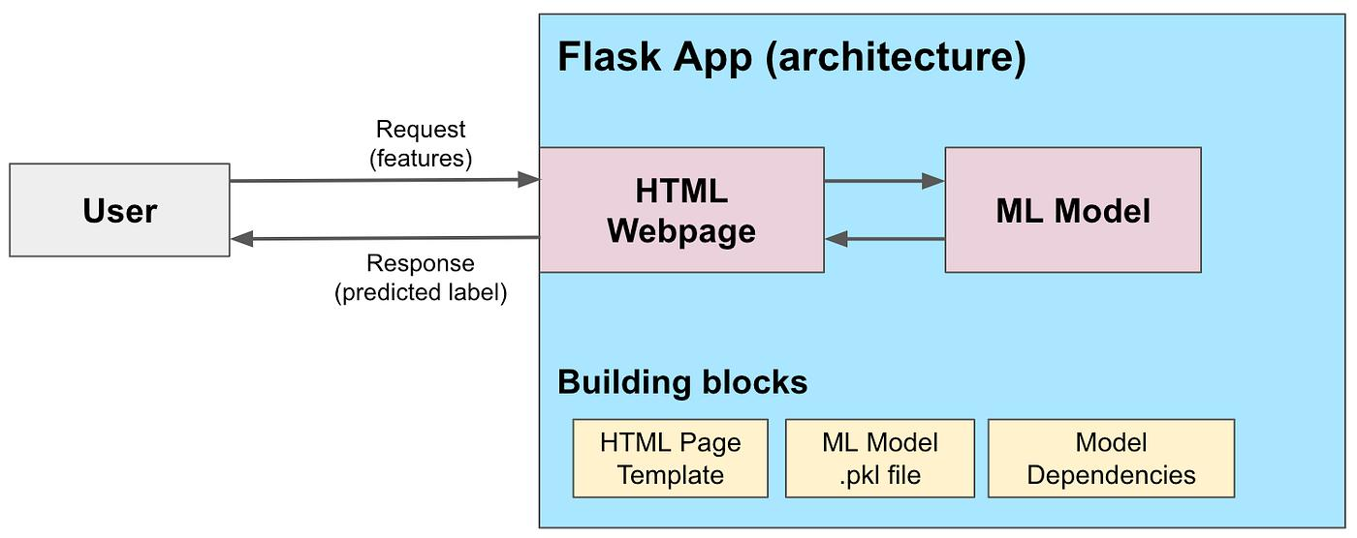
Solution Overview
ERRAM is a web-based application that performs real-time analysis of user input.
Key functionalities:
Accepts free-text input from users
Processes the text using a trained ML model
Returns:
Risk classification
Confidence score
Suggestions
The system is designed to be:
Lightweight
Interpretable
Fast
5

Slide 6
System Requirements
Hardware:
Minimum: Intel i3 / 4GB RAM
Recommended: 8GB RAM
Software:
Python 3.10+
Flask (Backend)
Scikit-learn (ML)
Pandas & NumPy
Web Browser
The system can run on standard machines without specialized hardware.
6

Slide 7
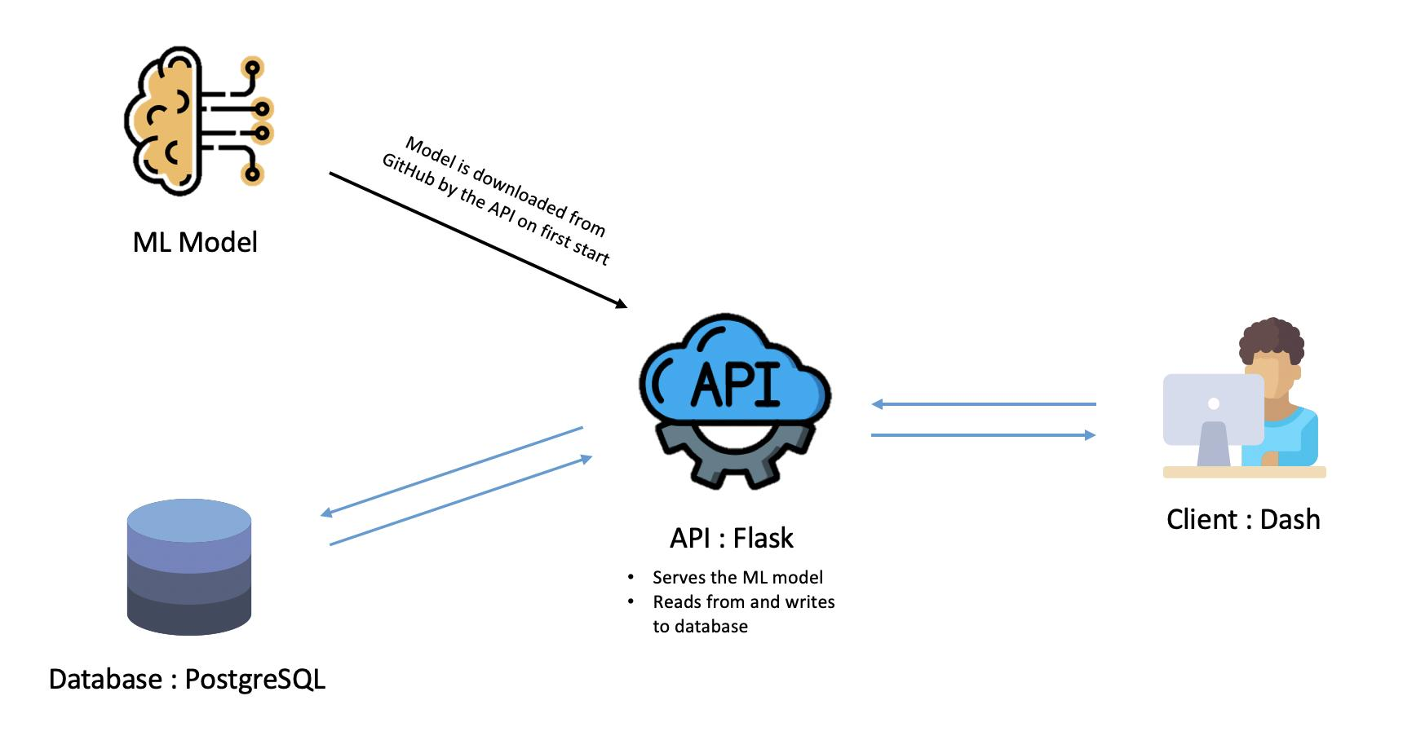
Model Approach and Dataset
The model uses:
TF-IDF (Term Frequency - Inverse Document Frequency)
Logistic Regression Classifier
TF-IDF converts text into numerical features based on word importance. Logistic Regression classifies the input into predefined risk categories.
This approach is chosen because it is:
Computationally efficient
Easy to interpret
Reliable for text classification
The model is trained on:
Kaggle Emotions Dataset
~16,000 labeled sentences
Each sentence is tagged with an emotion:
Joy, Love, Sadness ,Fear ,Anger, Surprise
These are later mapped to risk categories.
7

Slide 8
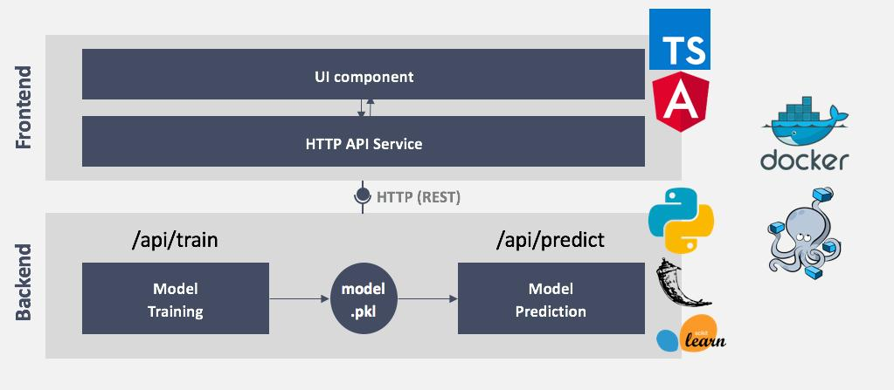
Architecture
The emotions are mapped to risk levels based on psychological interpretation:
Joy, Love → Low Risk
Anger, Surprise → Medium Risk
Sadness, Fear → High Risk
This mapping helps convert emotional classification into meaningful risk assessment.
ERRAM follows a 3-layer architecture:
Presentation Layer (Frontend)
HTML, CSS, JavaScript
User interaction
Application Layer (Backend)
Flask server
API handling
Model Layer
ML pipeline (TF-IDF + Logistic Regression)
.
8

Slide 9
Data Flow
User Input
↓
Frontend (HTML/CSS/JS)
↓
Flask API (/predict)
↓
Text Preprocessing
↓
TF-IDF Vectorization
↓
Logistic Regression Model
↓
Prediction (Low / Medium / High)
↓
Response (JSON)
↓
UI Display (Risk + Confidence + Suggestions)
.
9

Slide 10
Results
The system returns:
Risk Level (Low/Medium/High)
Confidence Score
Probability Distribution
Description of result
Personalized suggestions
This ensures transparency and usability.
Model Accuracy
Validation Accuracy: ~96%
Test Accuracy: ~96.5%
Observations:
High accuracy for clear emotions
Medium category slightly ambiguous due to natural language complexity
10

Slide 11
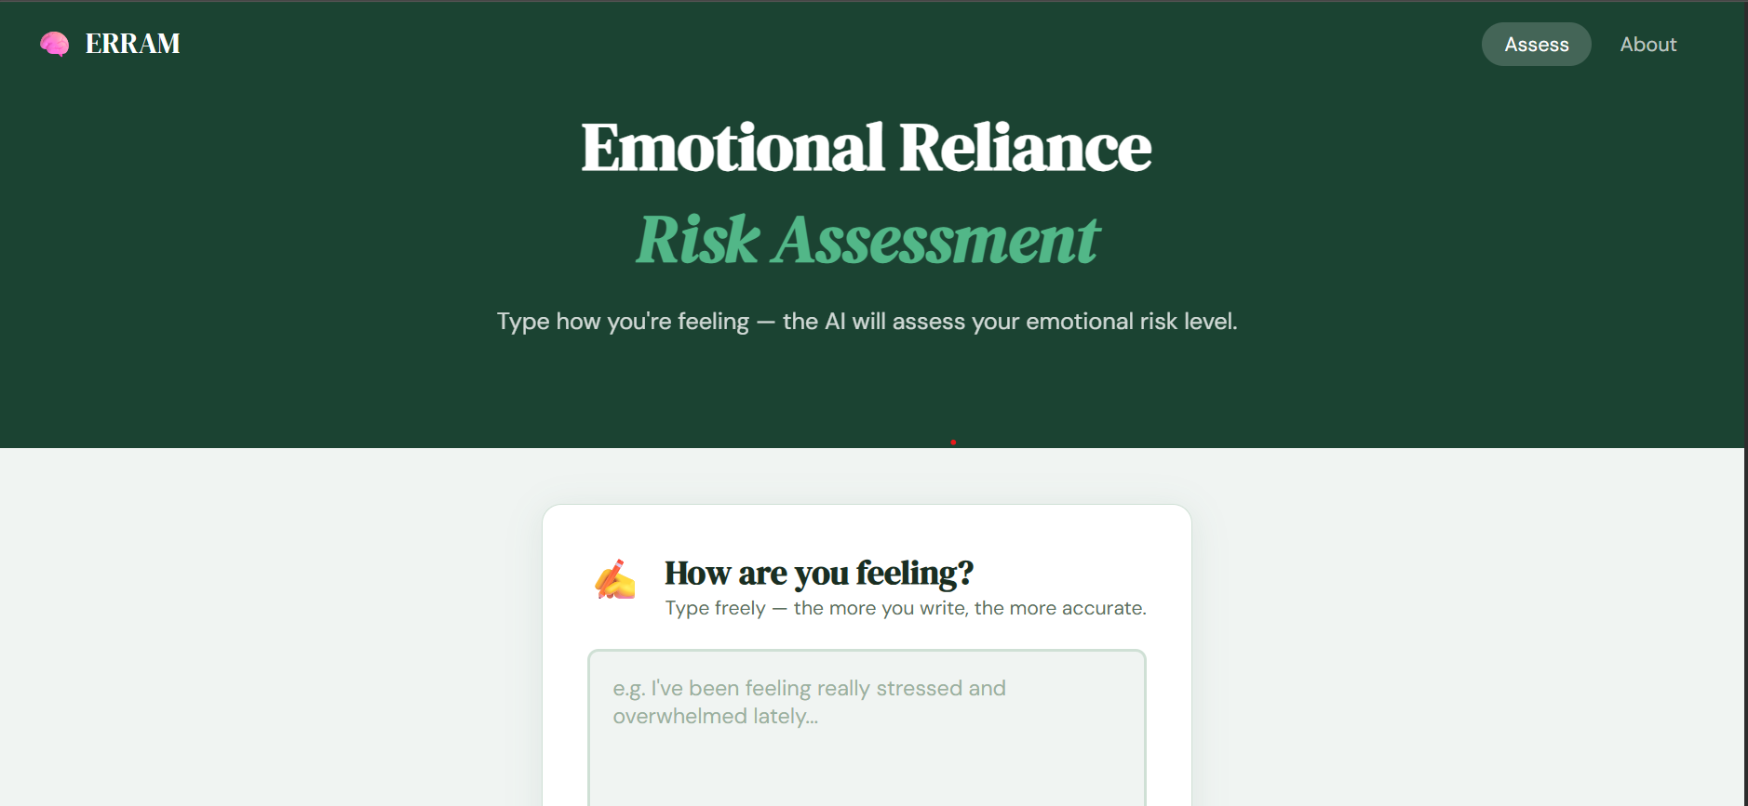
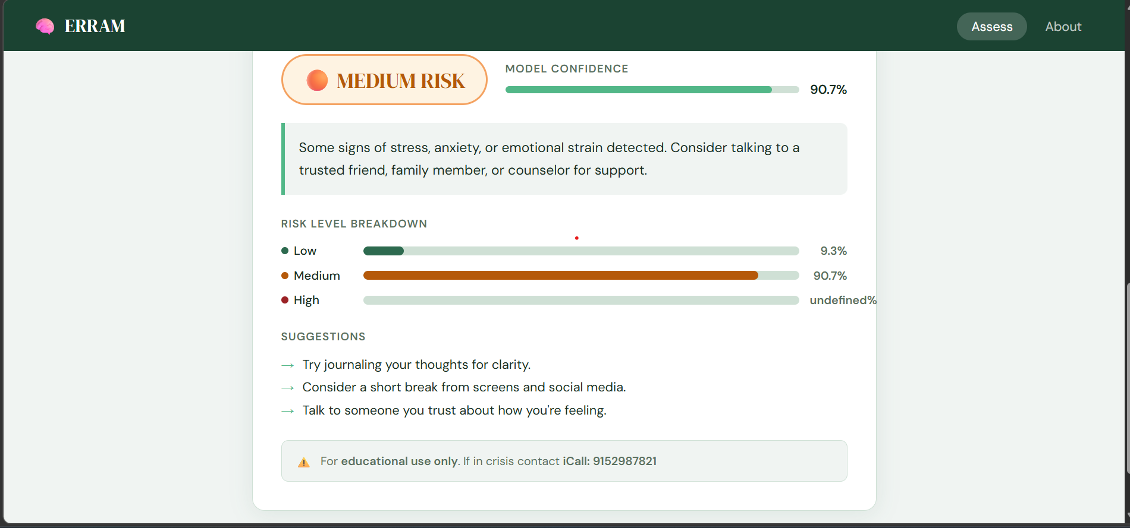
Live Application
11

Slide 12
Conclusion
ERRAM demonstrates that:
Emotional risk detection is feasible using lightweight ML techniques
Real-time monitoring can enhance responsible AI usage
The system is efficient, interpretable, and deployable
It provides a strong foundation for future advancements in AI-based emotional awareness systems.
Future Scope:
Possible improvements:
Use transformer-based models (BERT)
Context-aware conversation analysis
Emotion tracking over time
Mobile application development
12

Slide 13
Thank You
13

